Slide 1
A CHURCH
What Are Some Guidelines In Selecting
Part 2

Slide 2
Sound Guidelines
A church which respects the authority of the Scriptures
A church that belongs to and pleases Christ

Slide 3
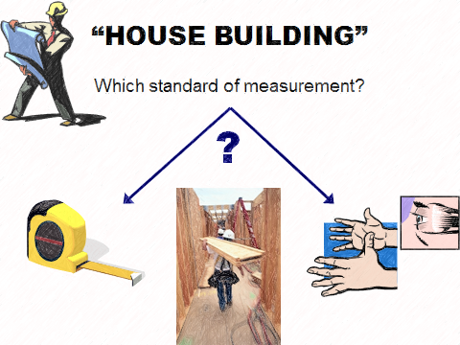
Objective standard
Subjective standard

Slide 4
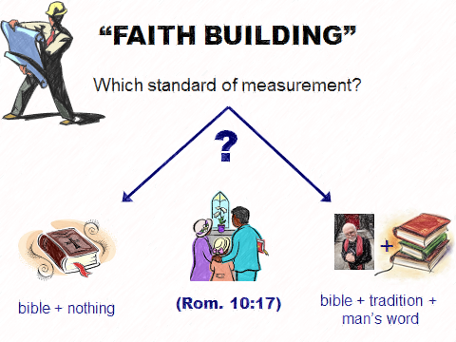

Slide 5
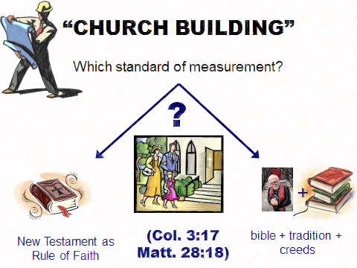

Slide 6

The Lord’s Church
Built at the right time: ~33 AD (Acts 2:47)
Built in the right place: Jerusalem (Acts 1:4; 2:5)
Built by the right person: Jesus (Matt. 16:18)
Uses the right rule: New Testament (Heb. 12:24)

Slide 7

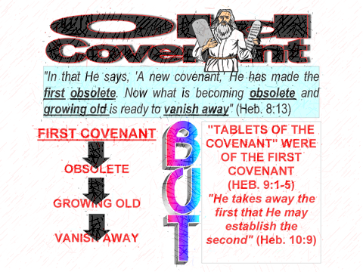

Slide 8
The Lord’s Church
worships in Spirit and Truth

Slide 9

WORSHIPS IN SPIRIT AND TRUTH
“²² You worship what you do not know; we know what we worship, for salvation is of the Jews. ²³ But the hour is coming, and now is, when the true worshipers will worship the Father in spirit and truth; for the Father is seeking such to worship Him. ²⁴ God is Spirit, and those who worship Him must worship in spirit and truth” (Jn. 4:22-24)
Right One
Right Way
Right Mind

